Slide 1

Improving Flash Flood Monitoring and Forecasting Capabilities in West Africa with Satellite Observations and Precipitation Forecasts
Configuration
Physics representation limitations
Calibration Strategy
BONUS – GFS Testing

Slide 2
Configuration
a-priori parametrization and gauge locations

Slide 3
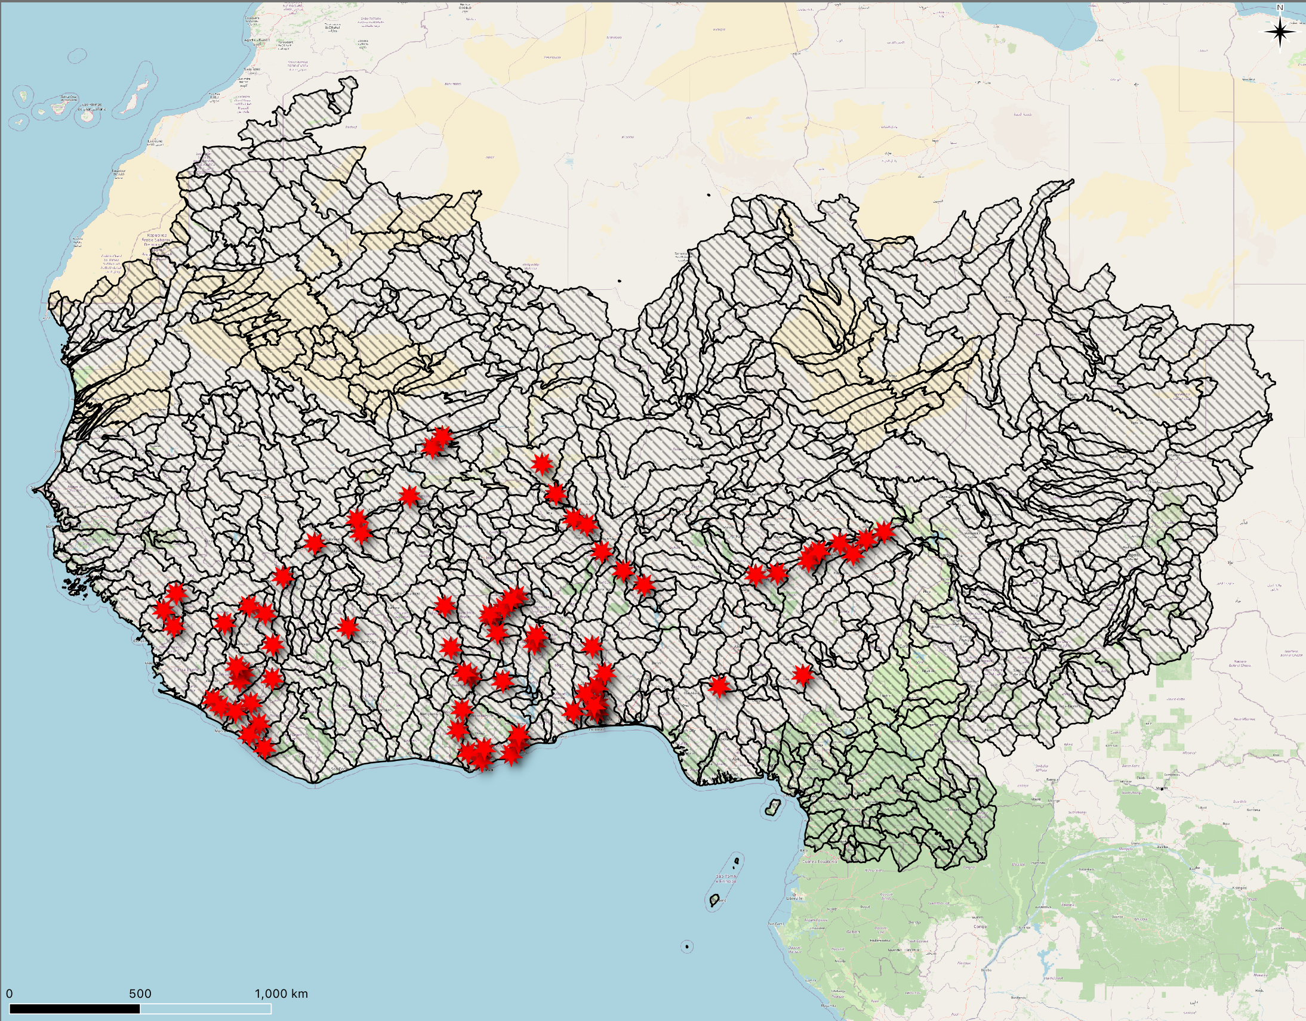
Gauge Locations
74 Stream Gauge Stations
Sparse temporal coverage for IMERG period of record (2001 – Present)
LOW confidence on correctness of some locations
Hydrologic Detective Work needed

Slide 4
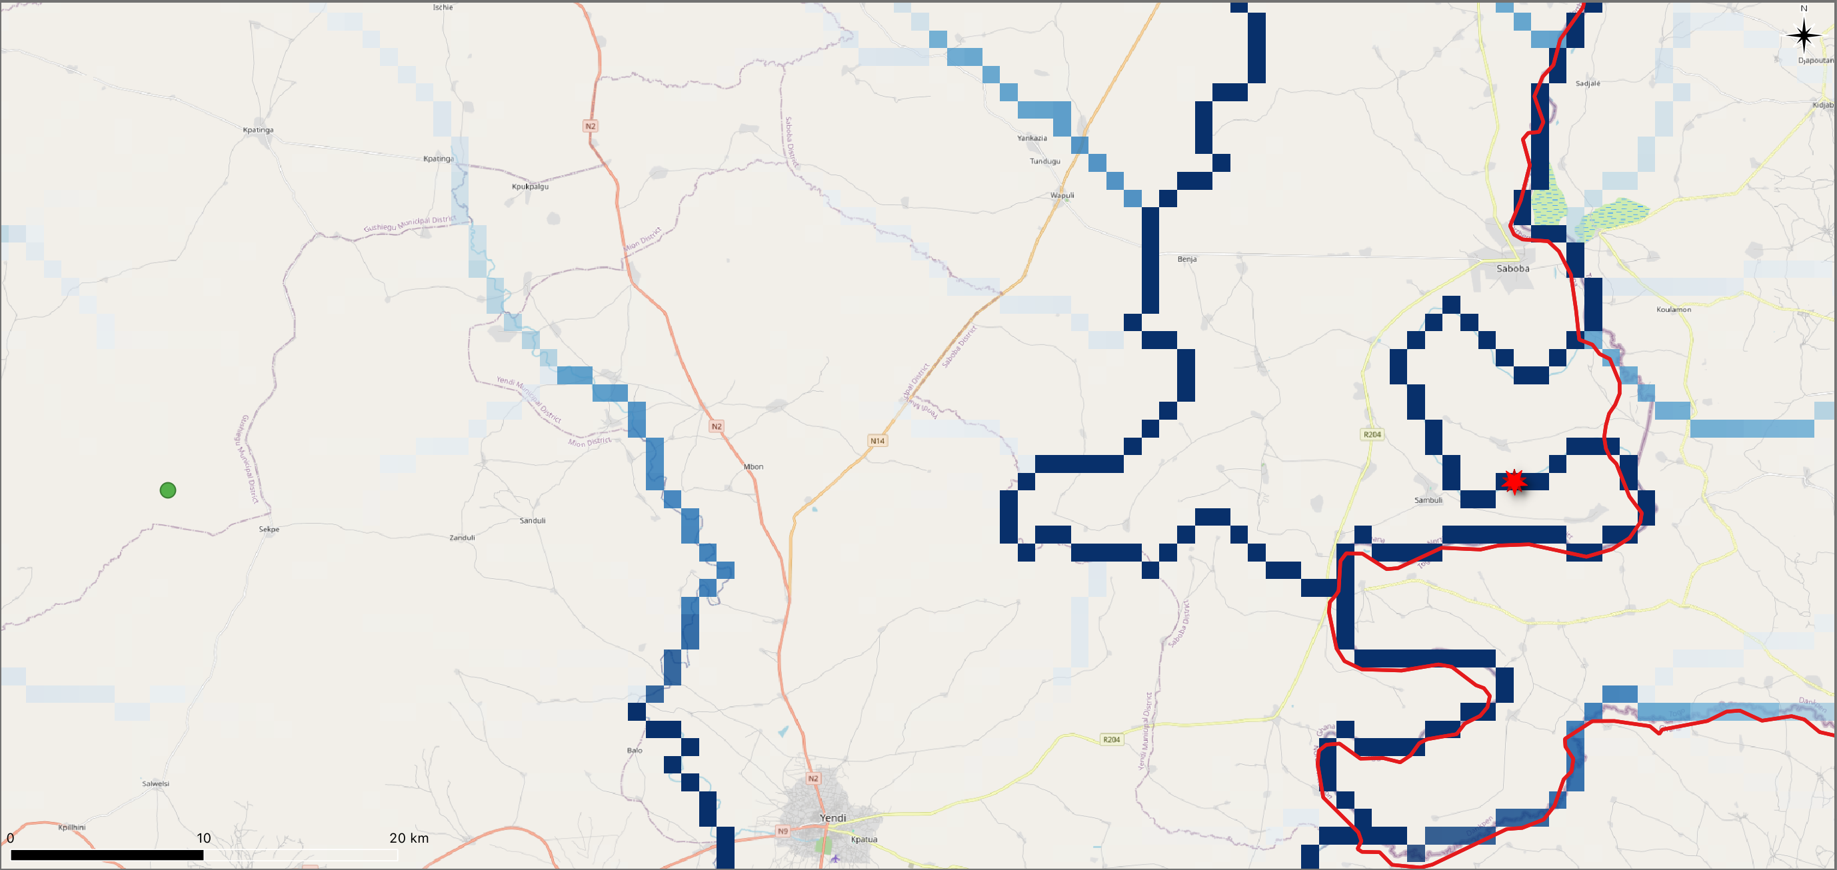
Incorrect locations from source (typo)
Good guess, plus city names helped
9.6032°, 0.3189°
9.5995°, -0.3153°

Slide 5
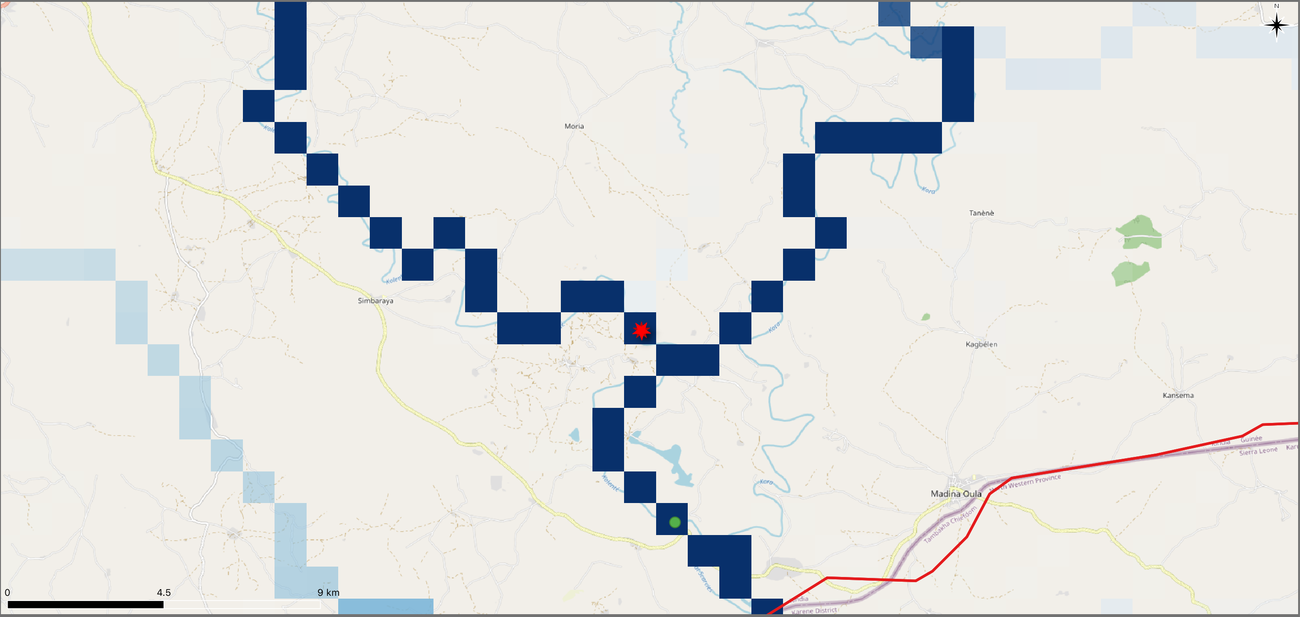
Tricky Location
DEM deficiencies/Drainage network features

Slide 6
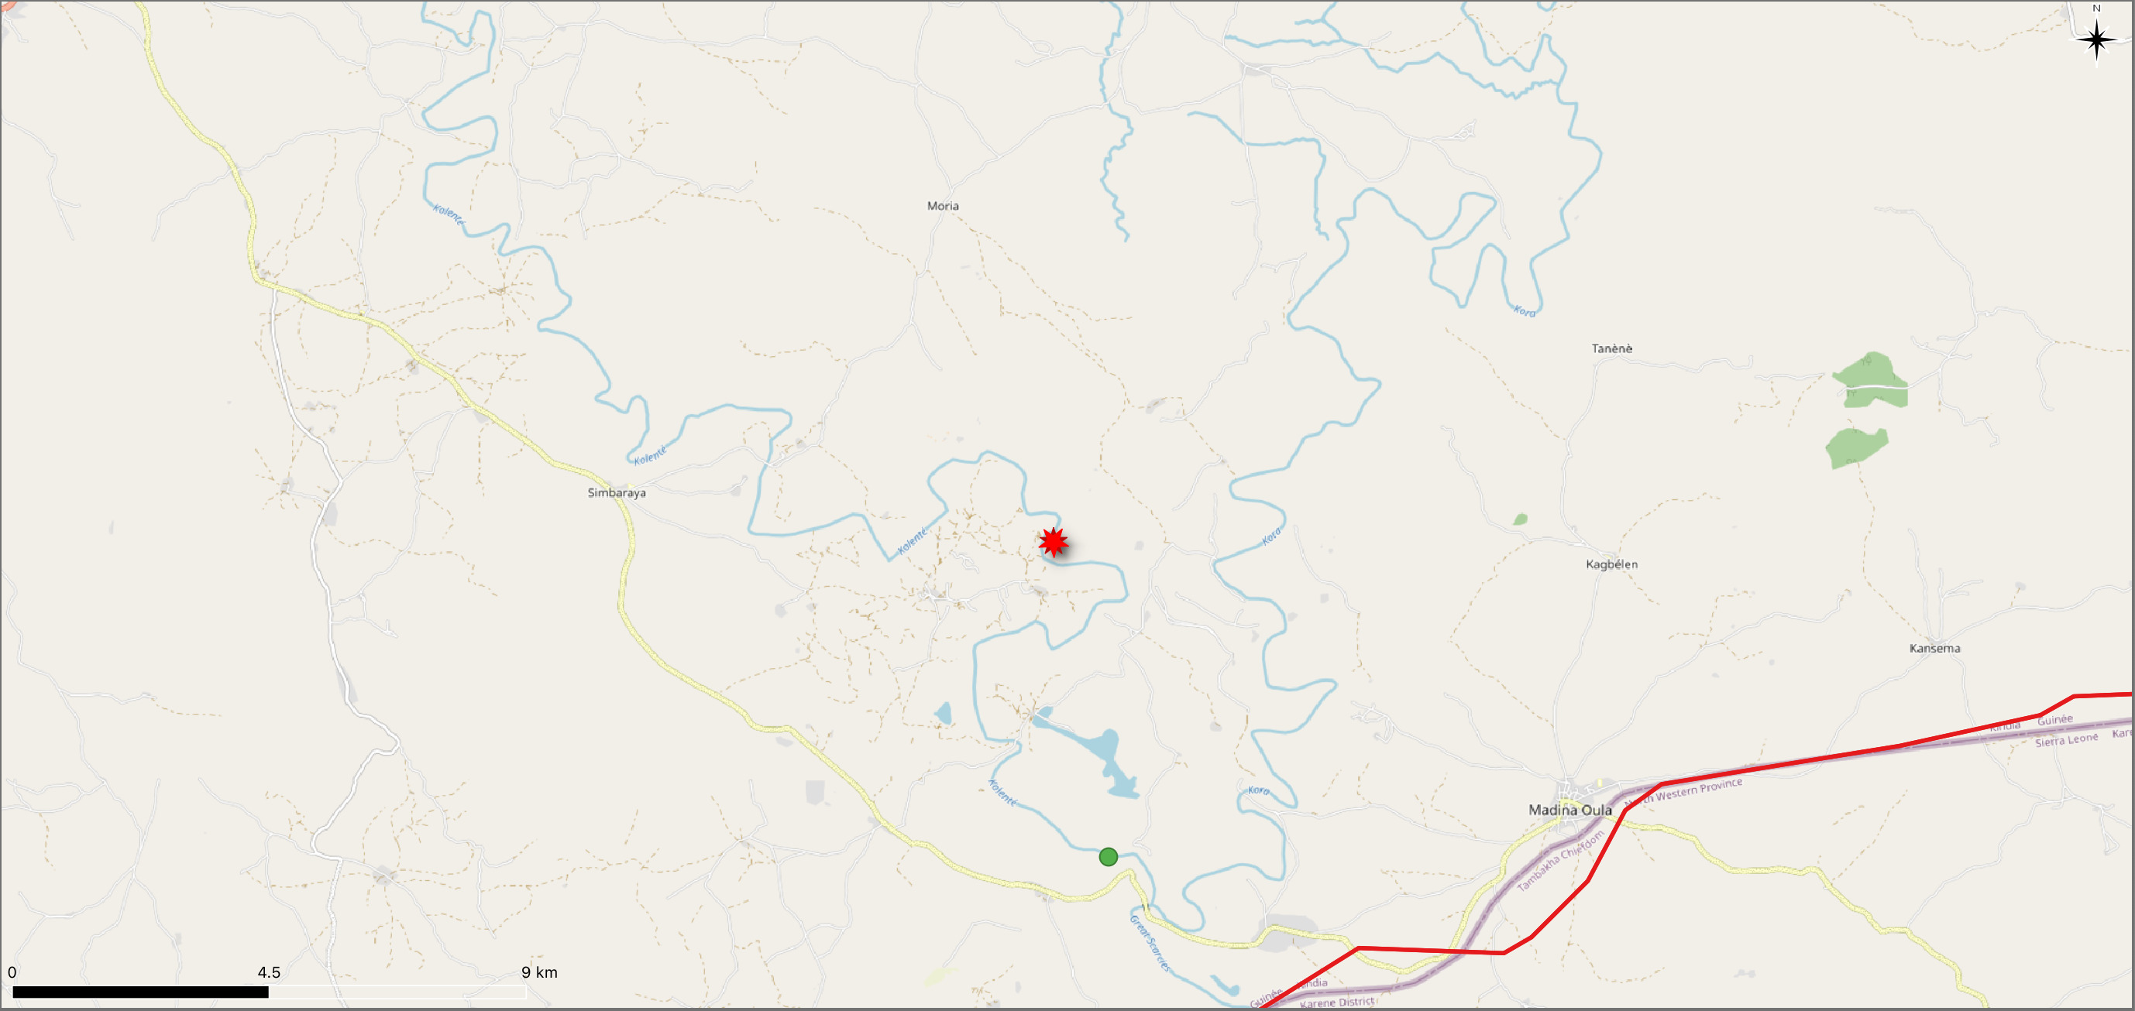
Tricky Location
DEM deficiencies/Drainage network features

Slide 7
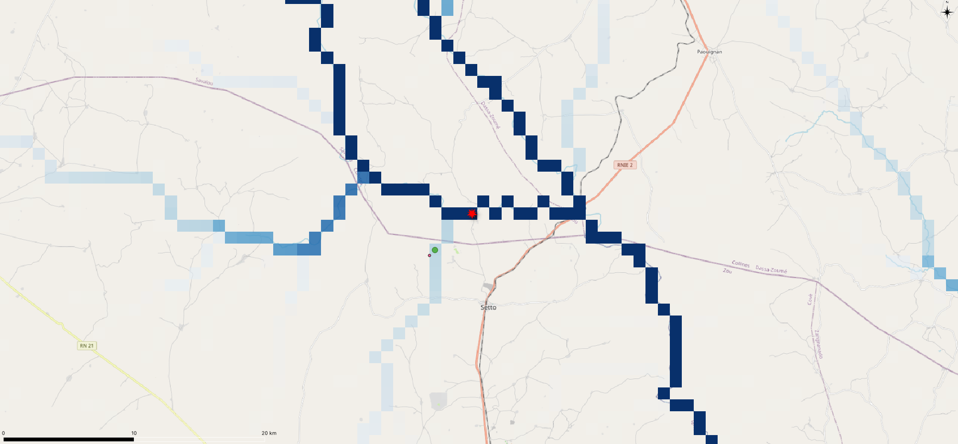
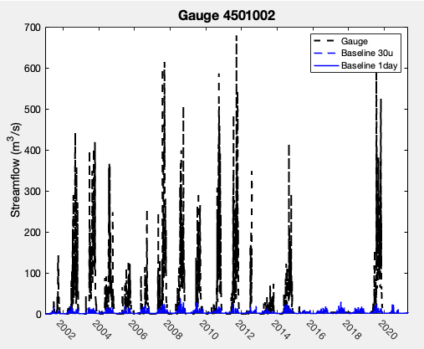
Puzzling location
Typical procedure: move to closest stream

Slide 8
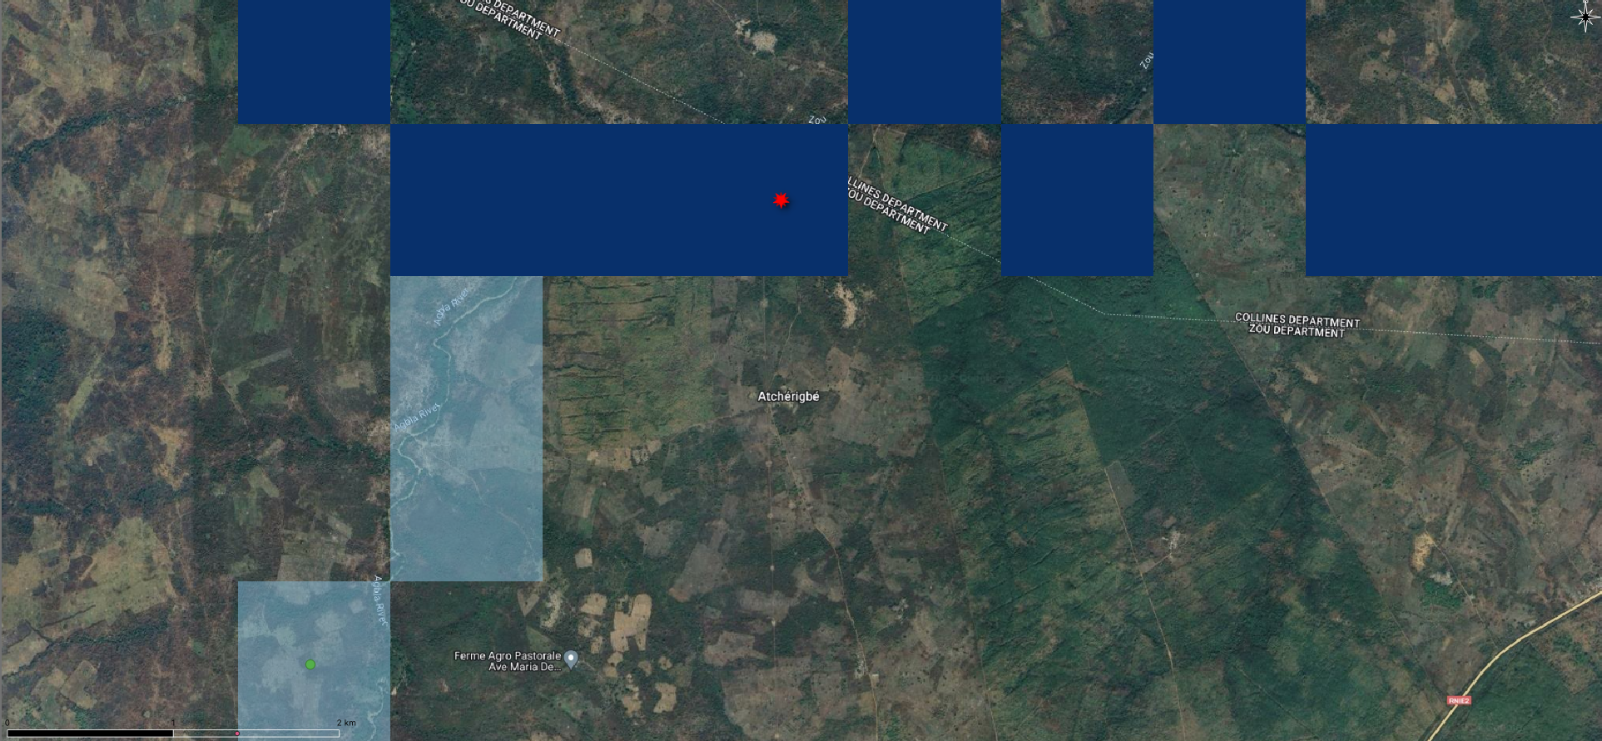
Puzzling location
Typical procedure: move to closest stream

Slide 9
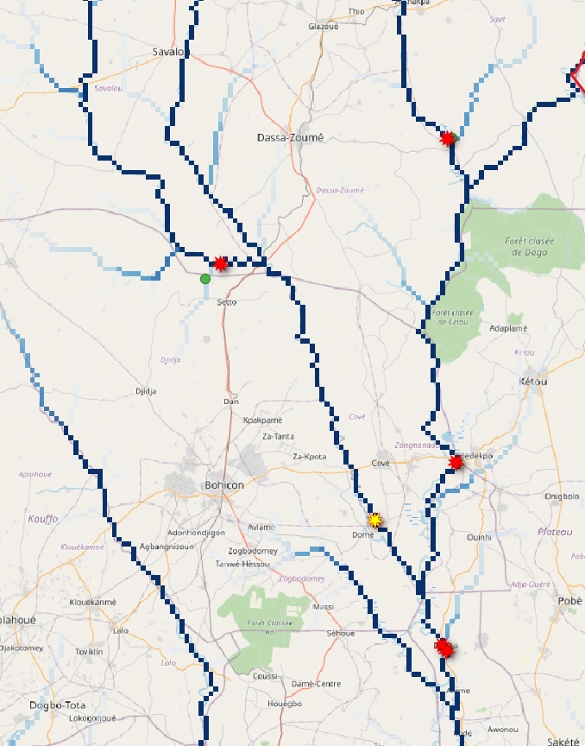
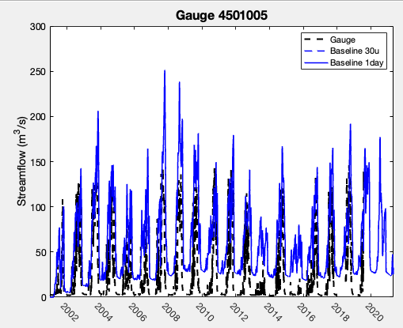
Puzzling location
Is this location it wrong?

Slide 10
Physics Limitations
Process-based approach

Slide 11
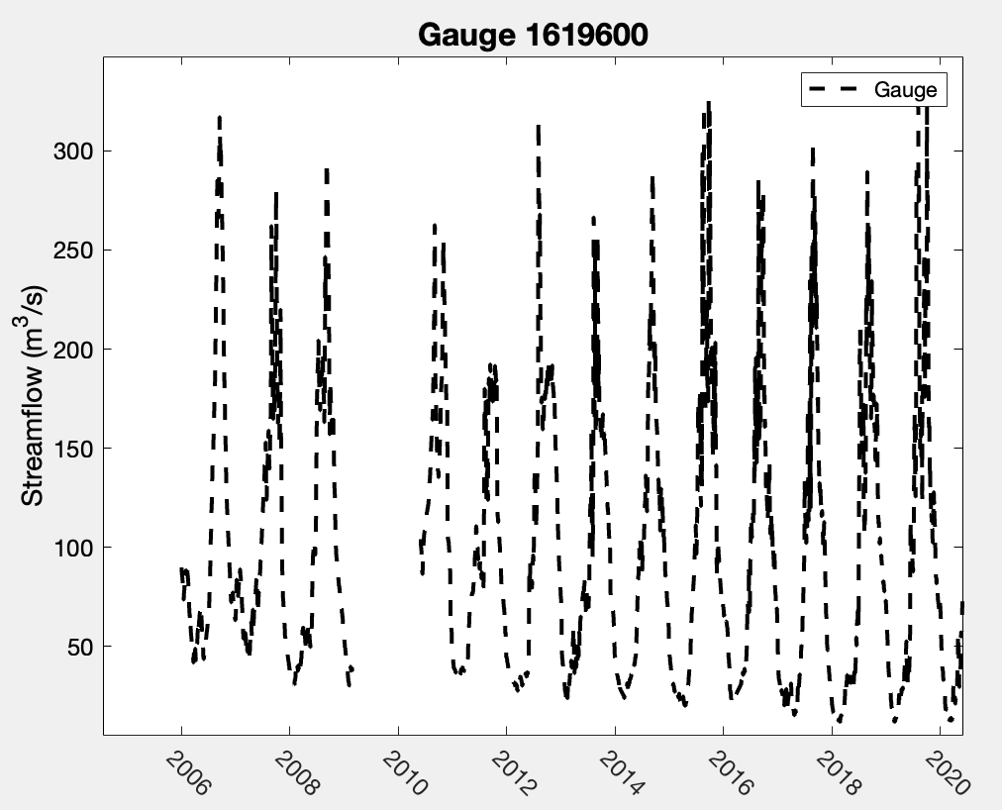
Process-based approach
Decline in baseflow? Real or an artifact of the data (i.e., QC)?

Slide 12
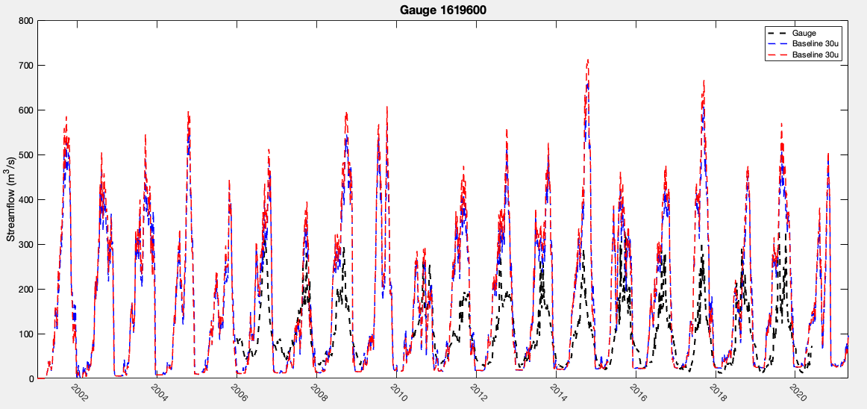
Process-based approach

Slide 13
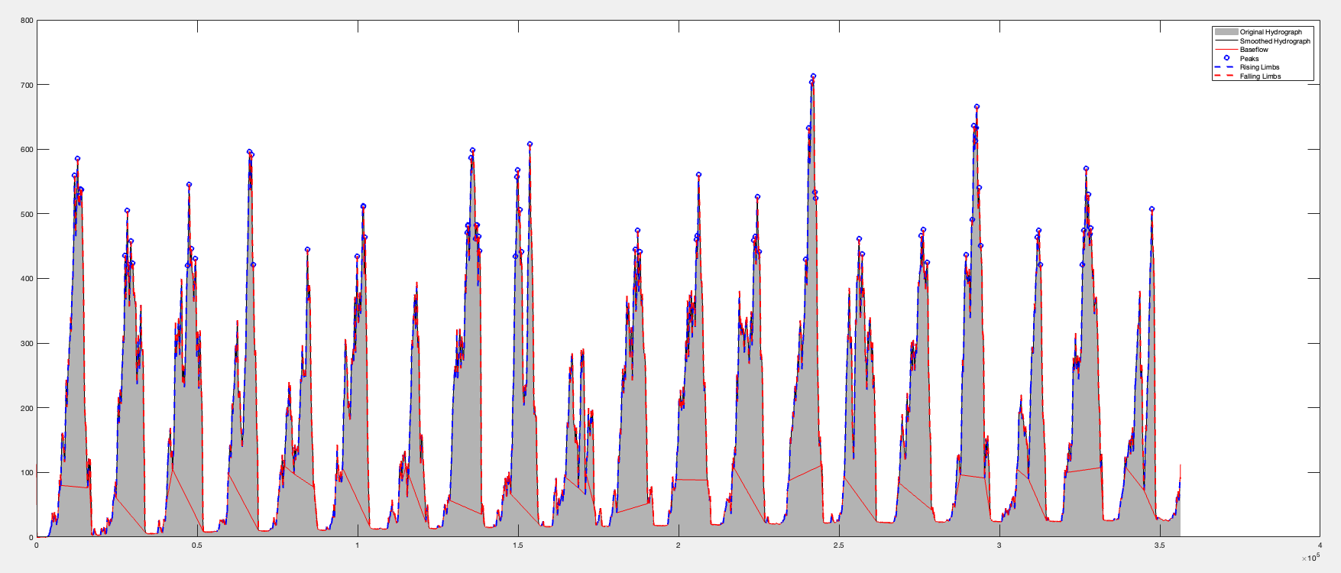
Process-based approach

Slide 14
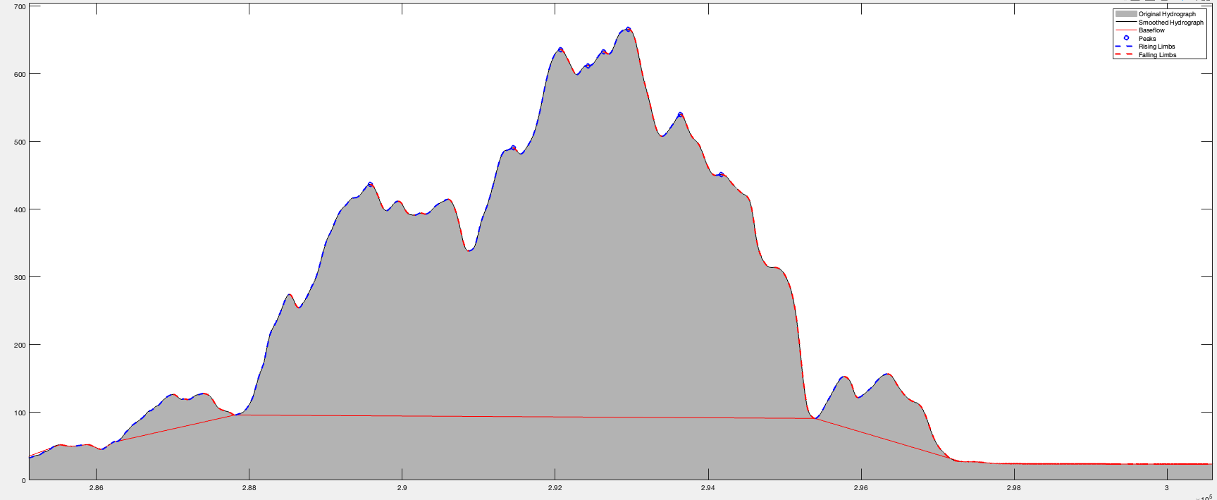
Process-based approach

Slide 15
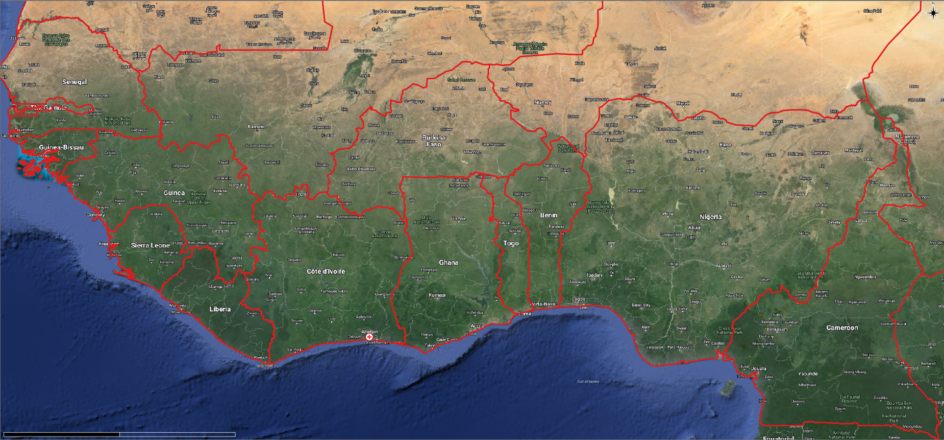
BONUS: GFS TEST
Ivory Coast, June 2018 event
Riviera Palmeraie, Mossikro, Paillet, Yopougon, Ananeraie;
Abidjan Abidjan and in country towns including, Tiassalé, Toulepleu, Sanpedro

Slide 16
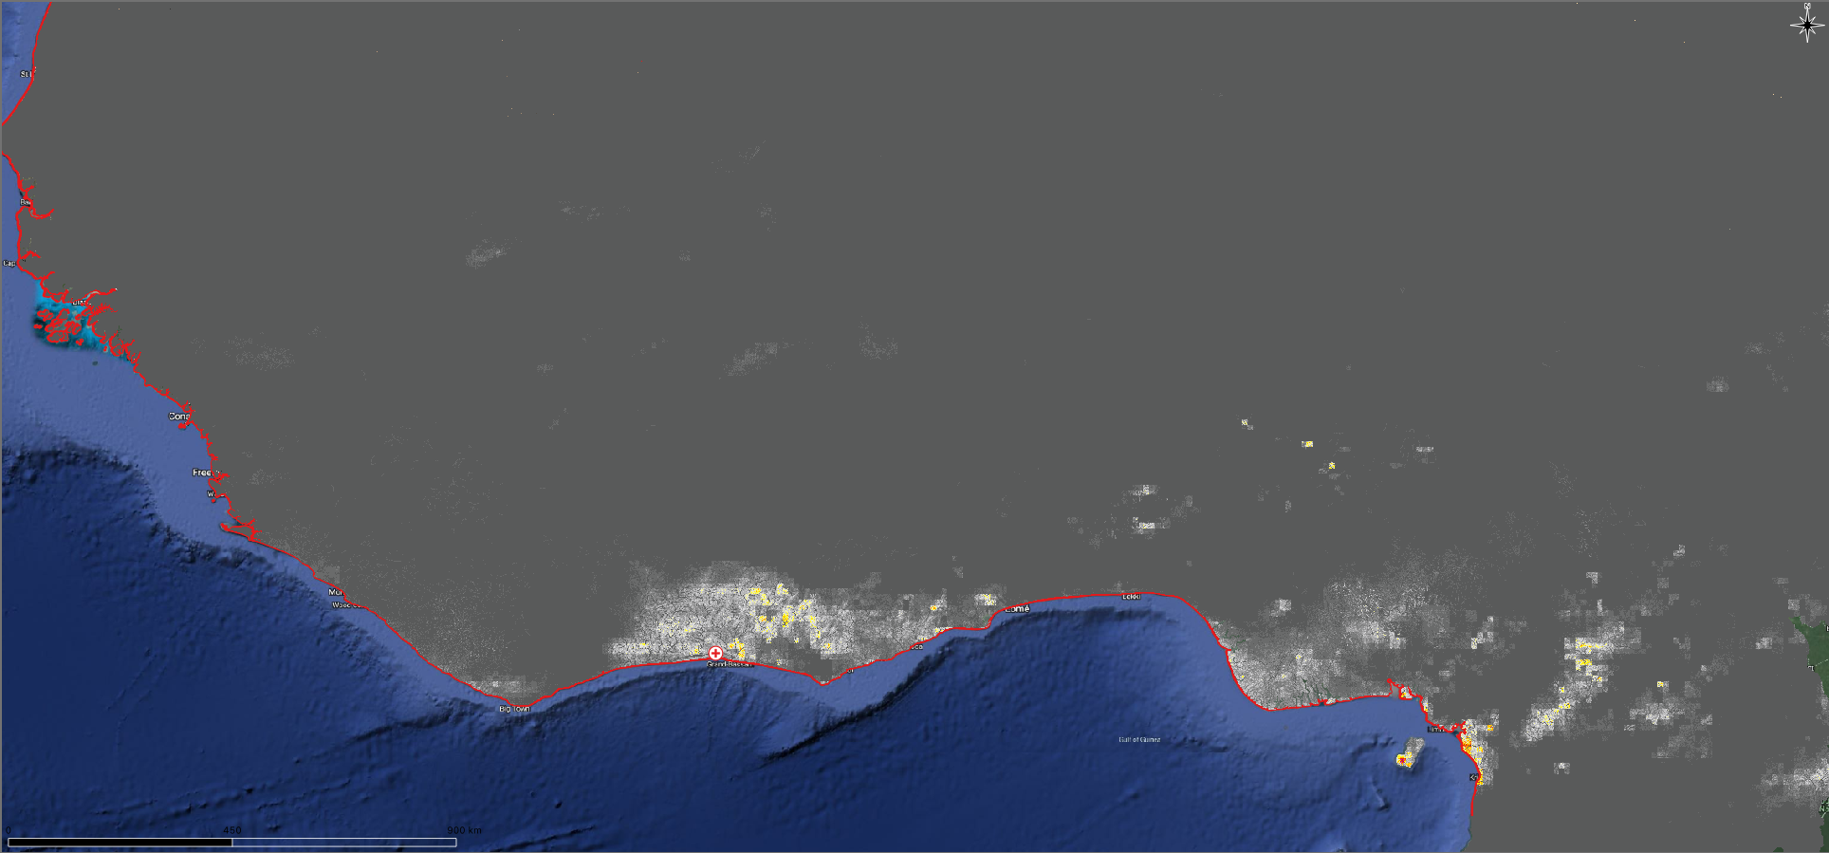
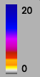
BONUS: GFS TEST
Ivory Coast, June 2018 event
Riviera Palmeraie, Mossikro, Paillet, Yopougon, Ananeraie;
Abidjan Abidjan and in country towns including, Tiassalé, Toulepleu, Sanpedro
IMERG

Slide 17
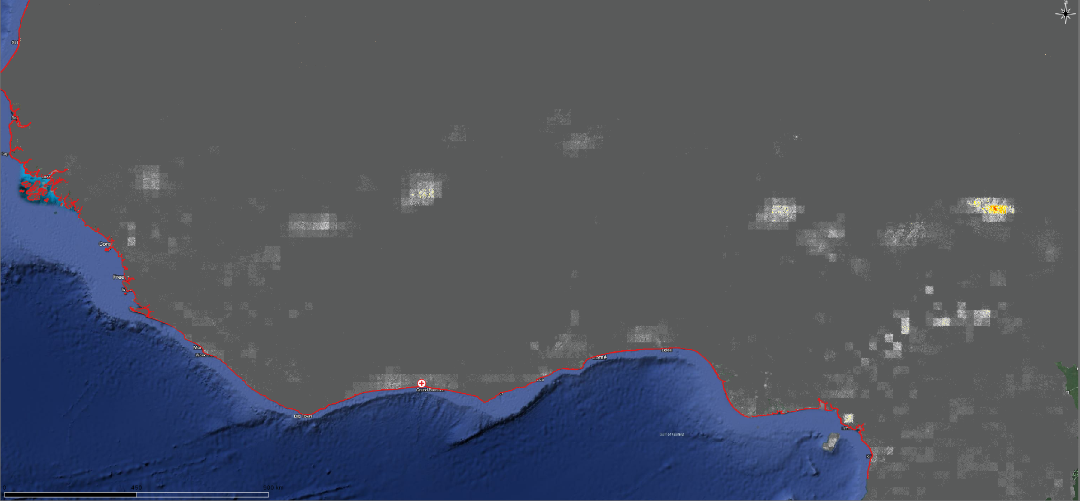
BONUS: GFS TEST
Ivory Coast, June 2018 event
Riviera Palmeraie, Mossikro, Paillet, Yopougon, Ananeraie;
Abidjan Abidjan and in country towns including, Tiassalé, Toulepleu, Sanpedro
4 days

Slide 18
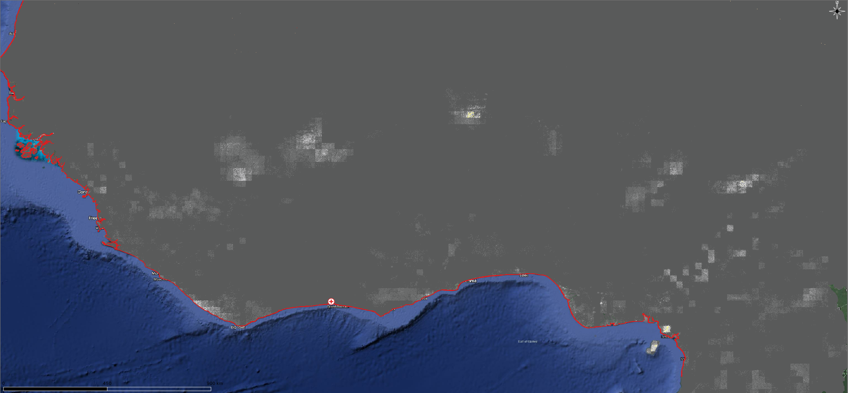
BONUS: GFS TEST
Ivory Coast, June 2018 event
Riviera Palmeraie, Mossikro, Paillet, Yopougon, Ananeraie;
Abidjan Abidjan and in country towns including, Tiassalé, Toulepleu, Sanpedro
3 days

Slide 19
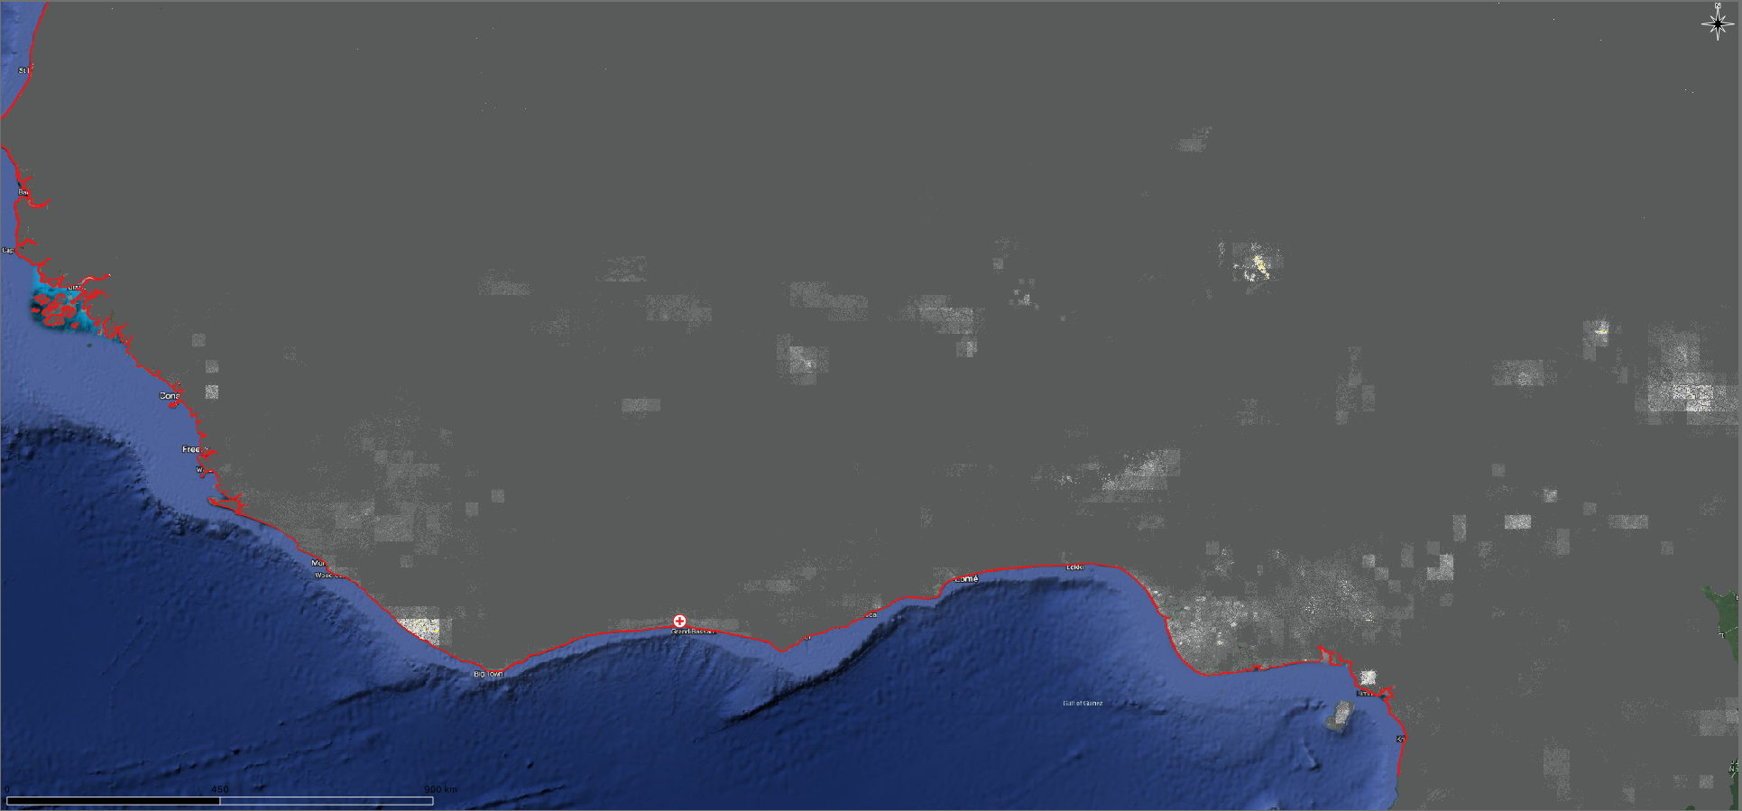
BONUS: GFS TEST
Ivory Coast, June 2018 event
Riviera Palmeraie, Mossikro, Paillet, Yopougon, Ananeraie;
Abidjan Abidjan and in country towns including, Tiassalé, Toulepleu, Sanpedro
2 days

Slide 20
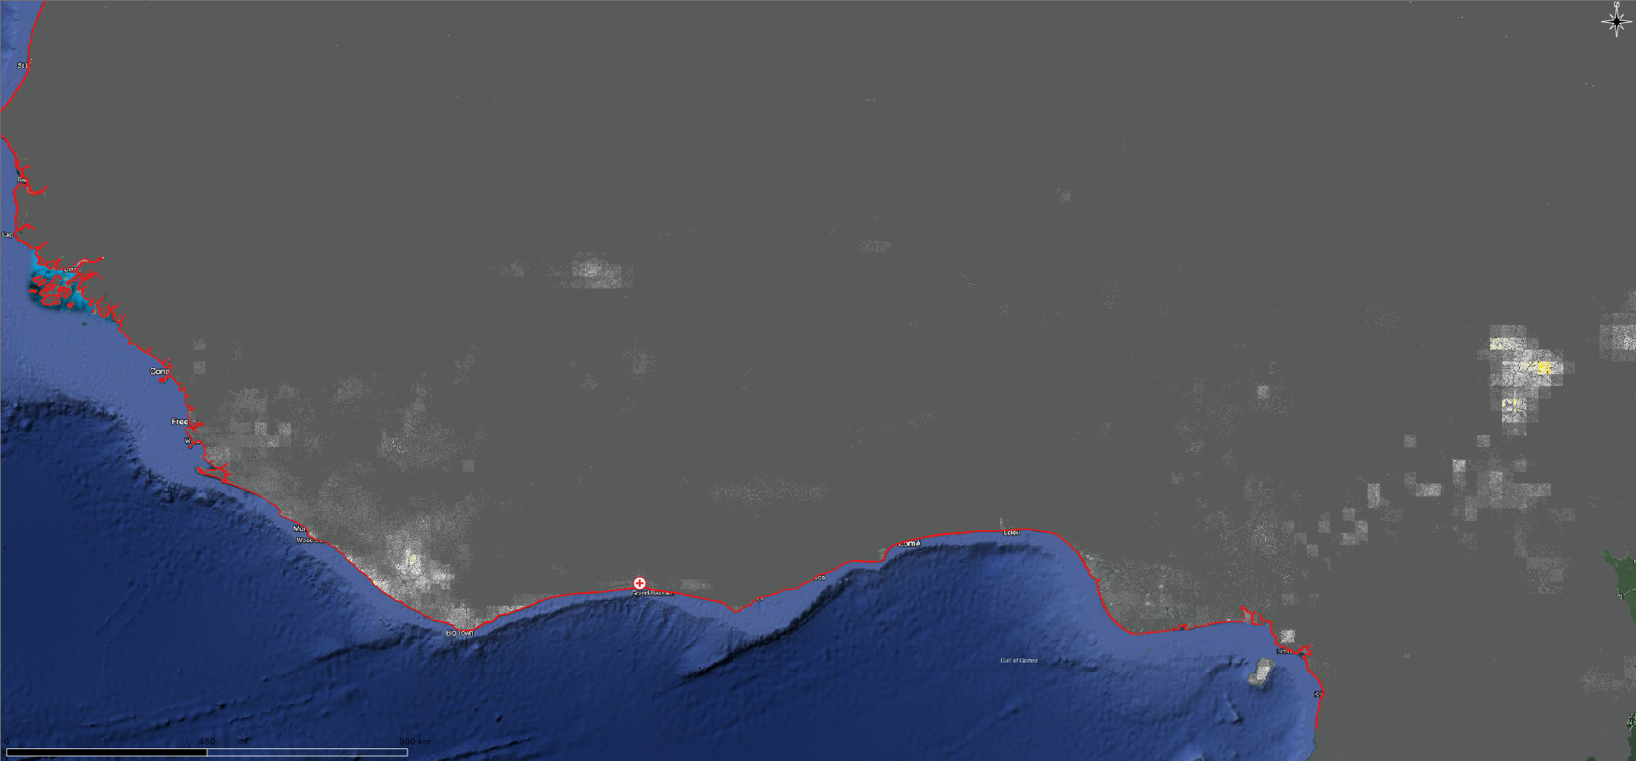
BONUS: GFS TEST
Ivory Coast, June 2018 event
Riviera Palmeraie, Mossikro, Paillet, Yopougon, Ananeraie;
Abidjan Abidjan and in country towns including, Tiassalé, Toulepleu, Sanpedro
1 days

Slide 21
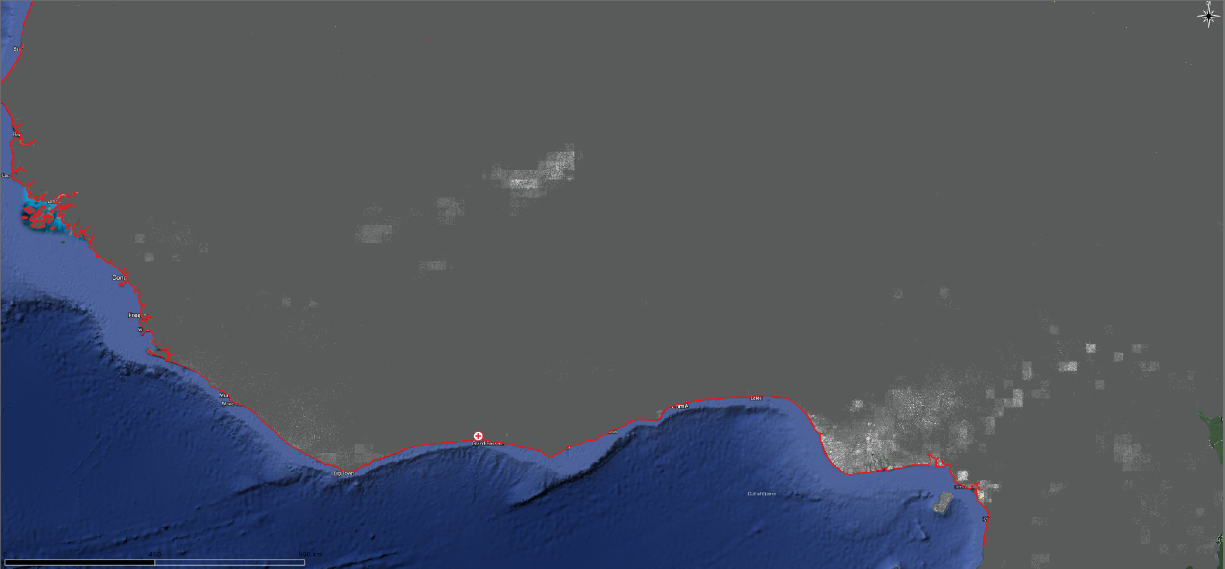
BONUS: GFS TEST
Ivory Coast, June 2018 event
Riviera Palmeraie, Mossikro, Paillet, Yopougon, Ananeraie;
Abidjan Abidjan and in country towns including, Tiassalé, Toulepleu, Sanpedro
0 days

Slide 22
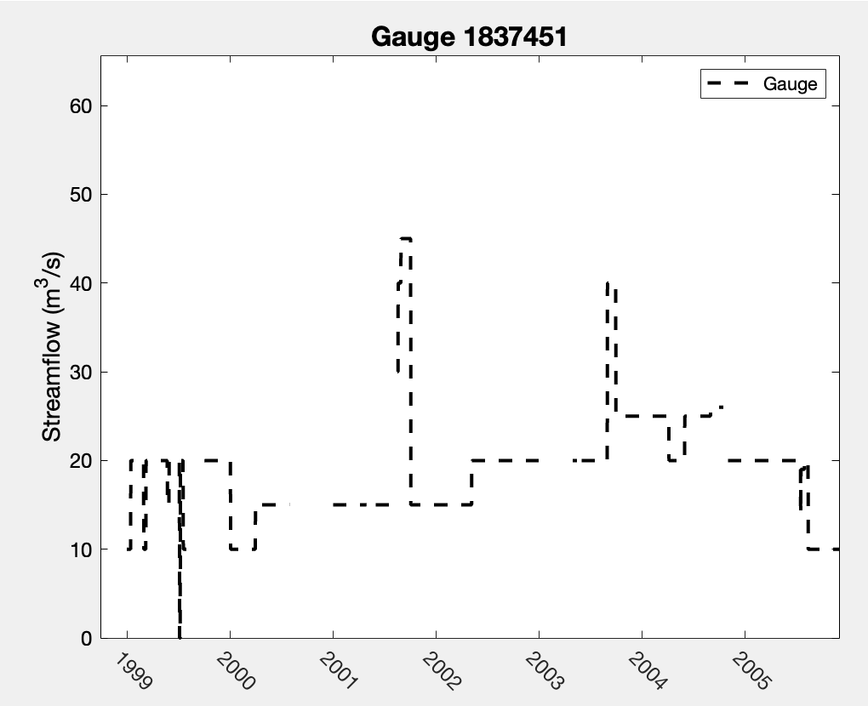
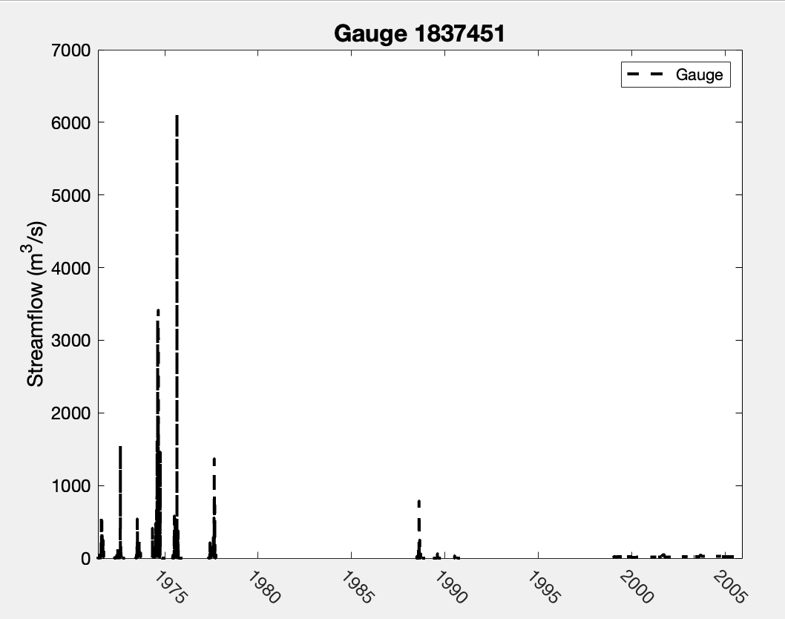
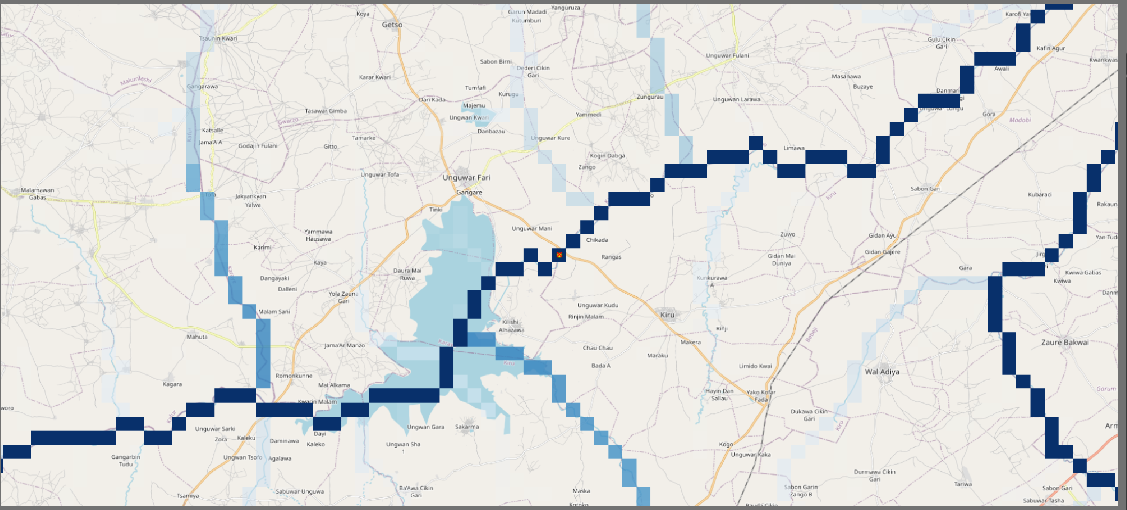
What do you think the flow direction is?
Gauge 1837451

Slide 23
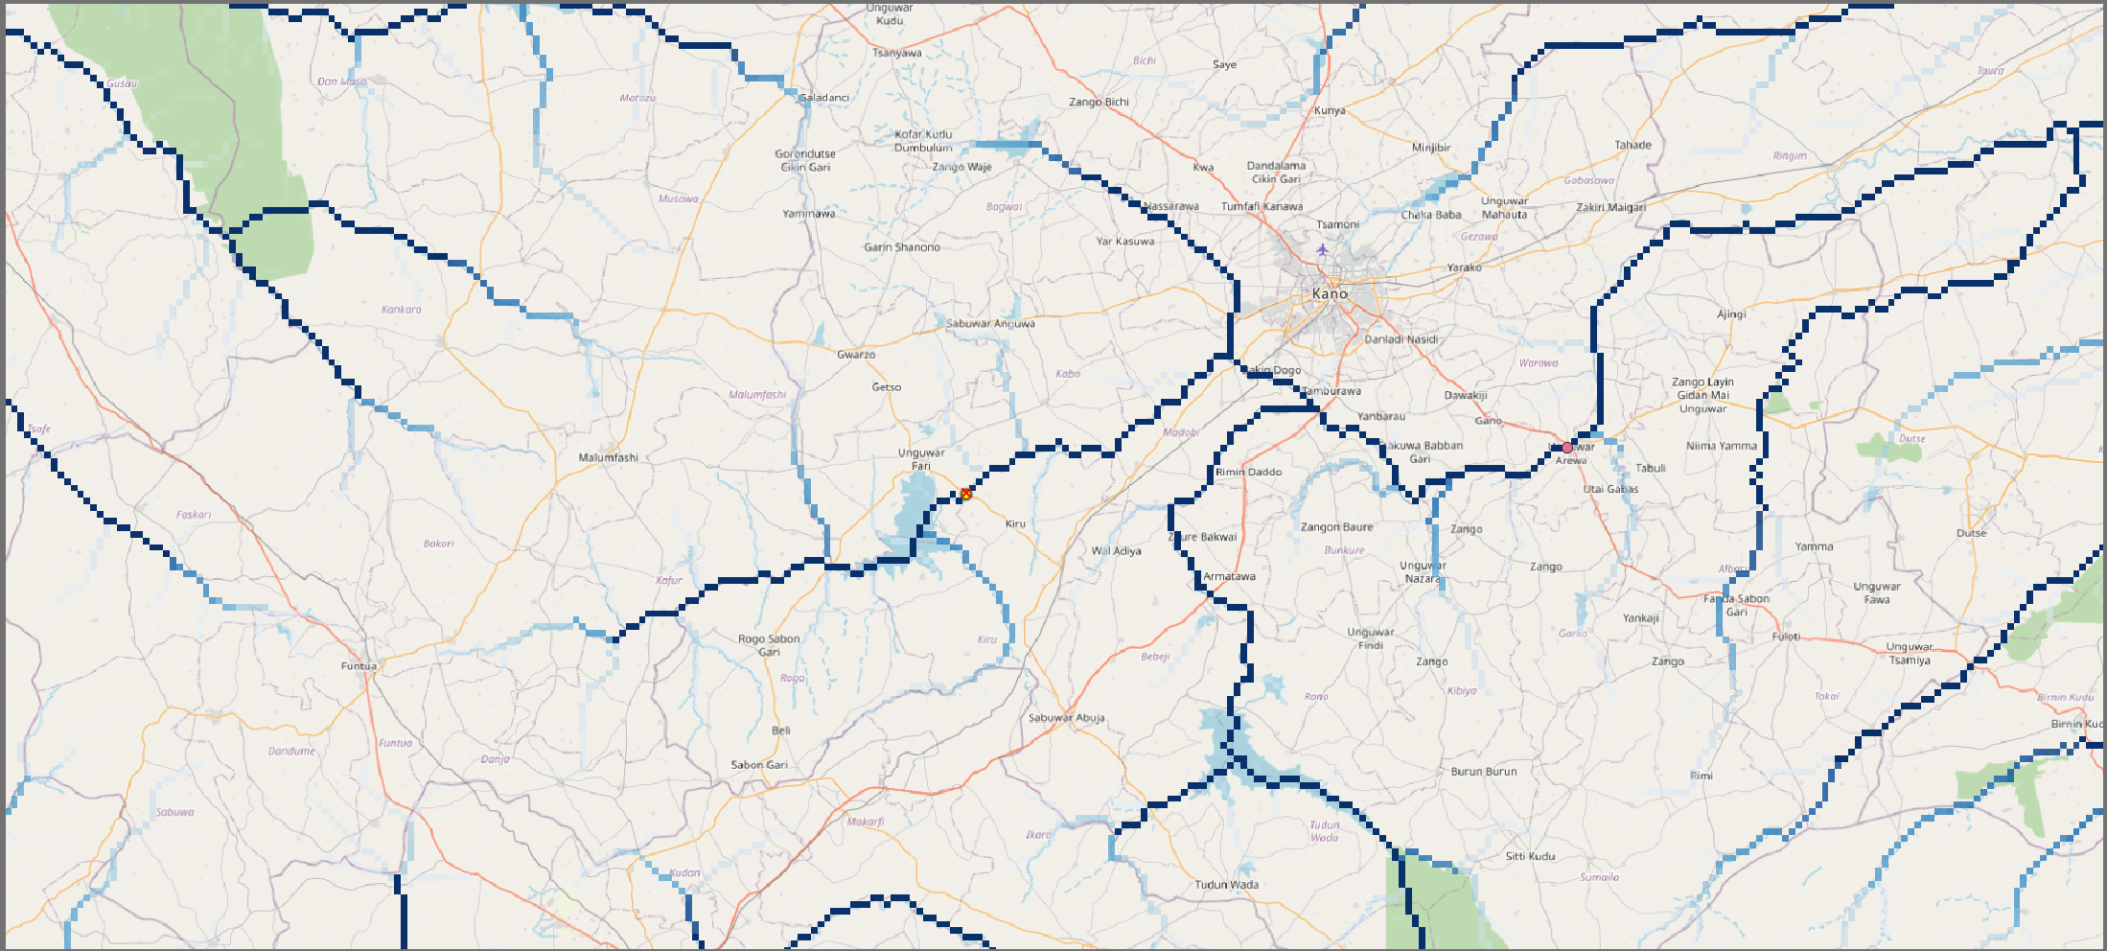
Gauge 1837410

Slide 24
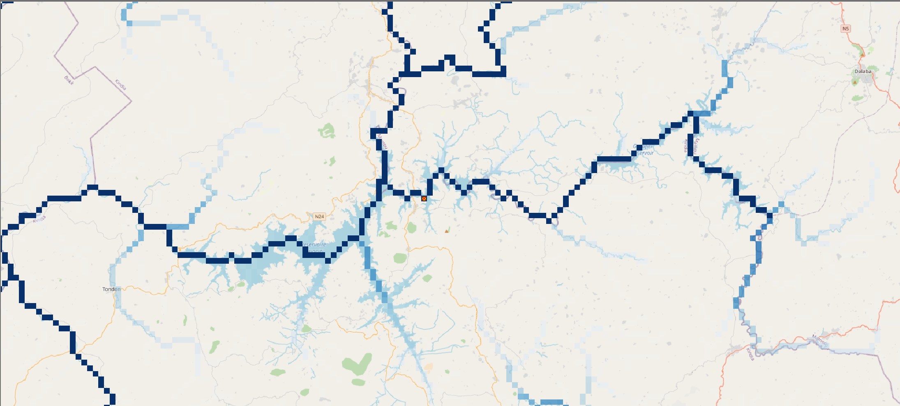
Gauge 1616700

Slide 25
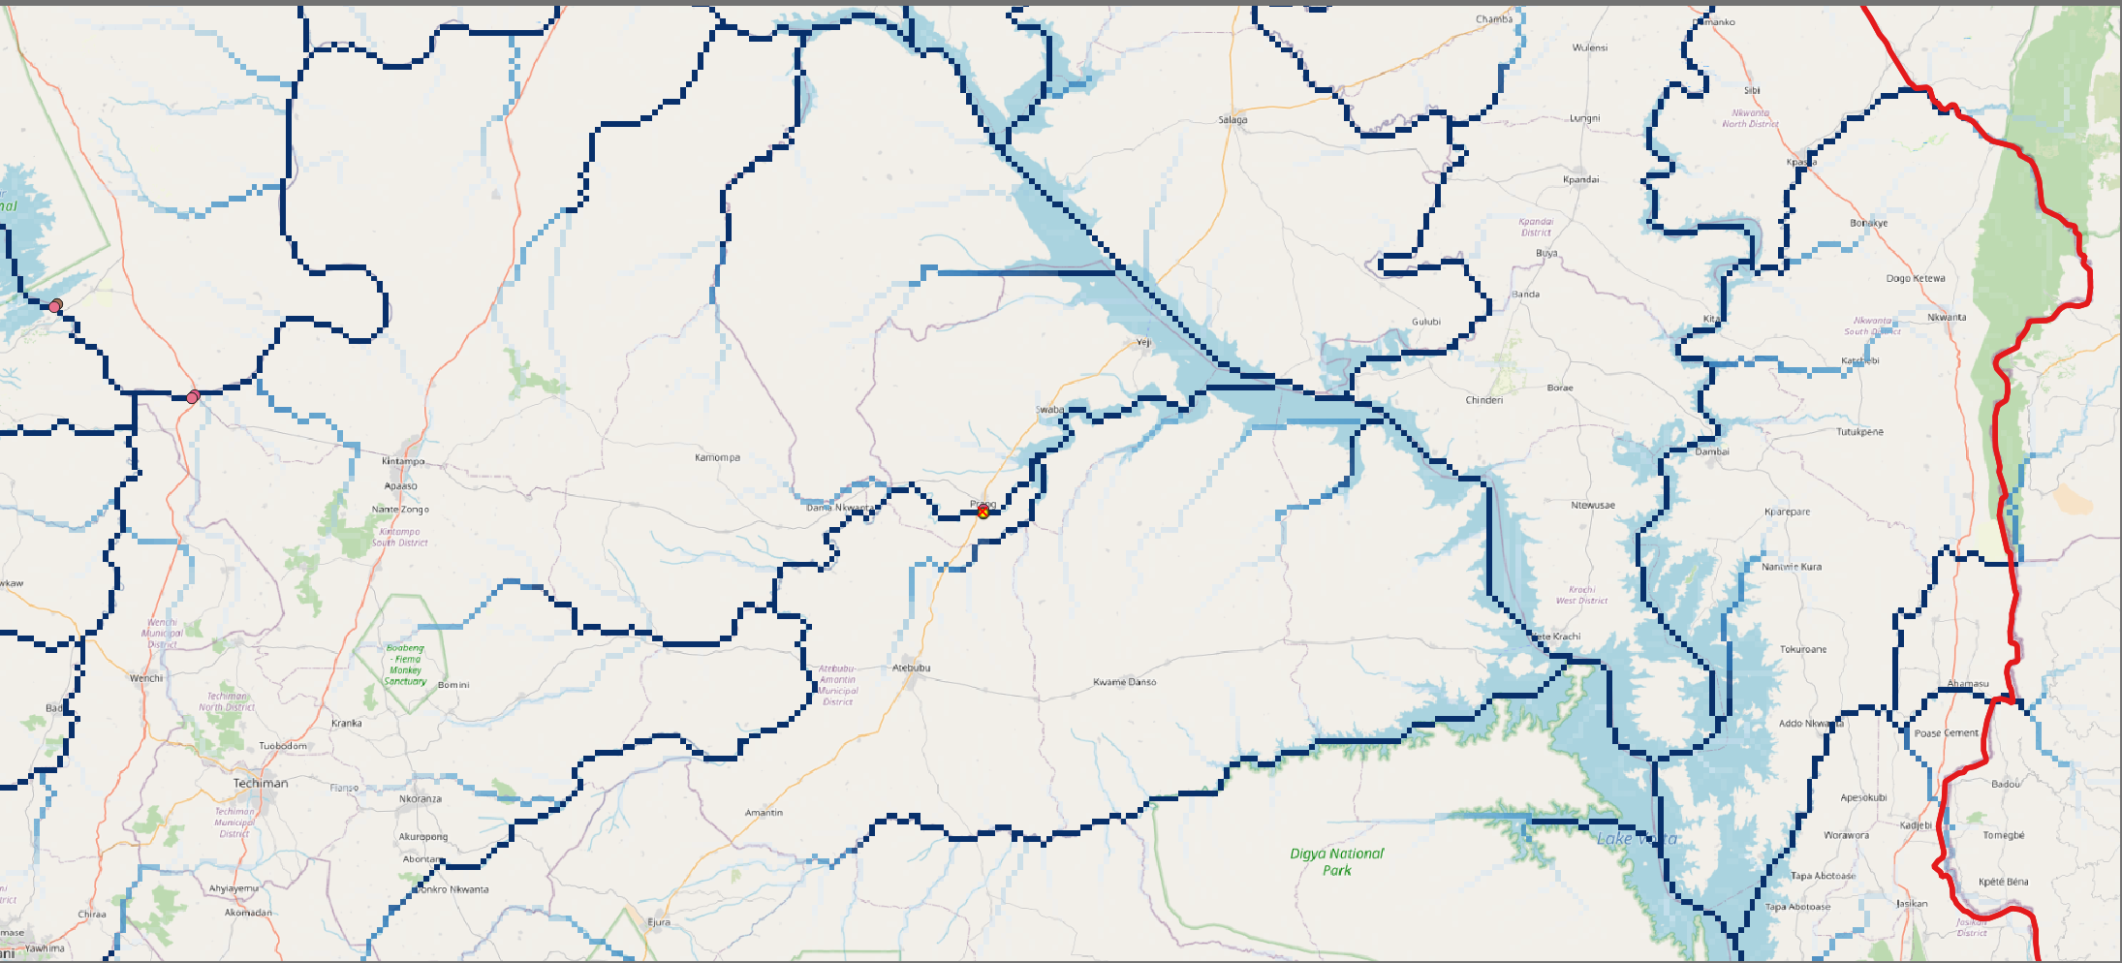

Slide 26
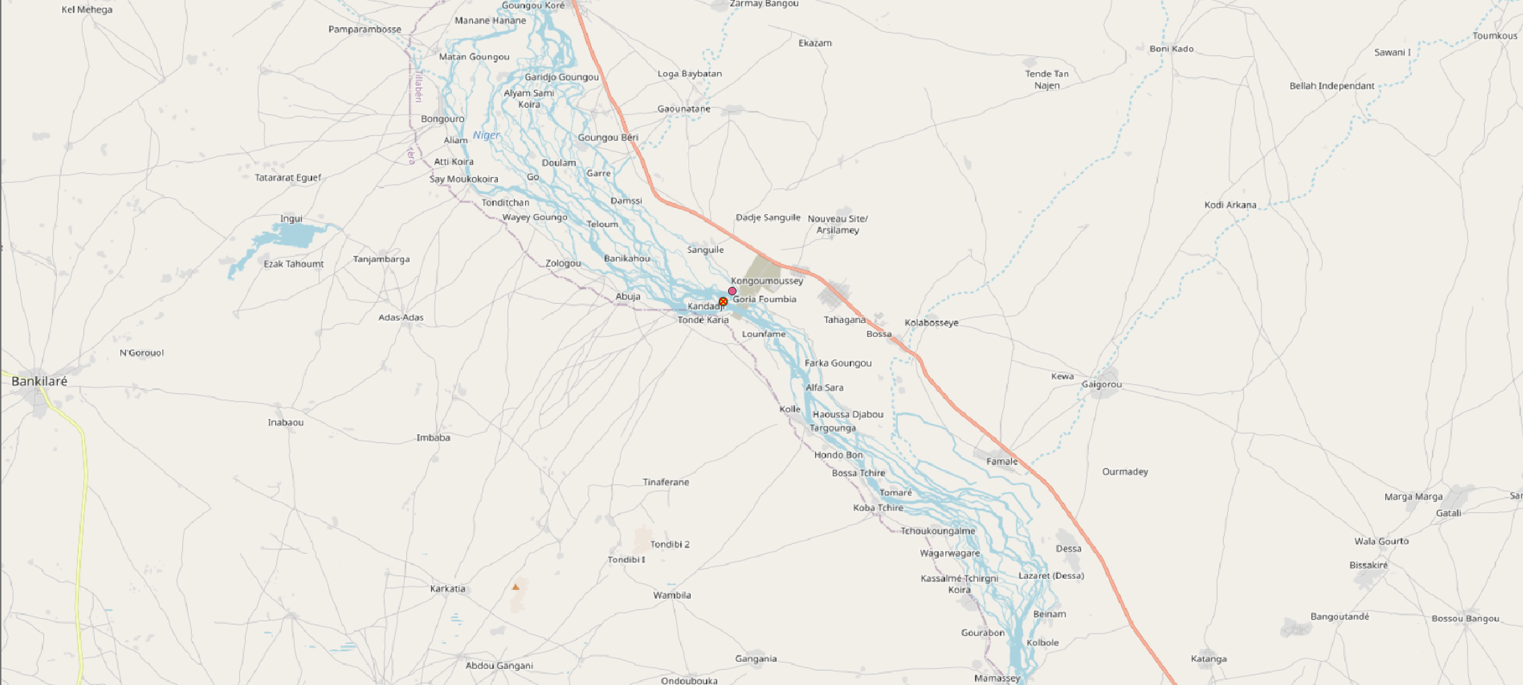
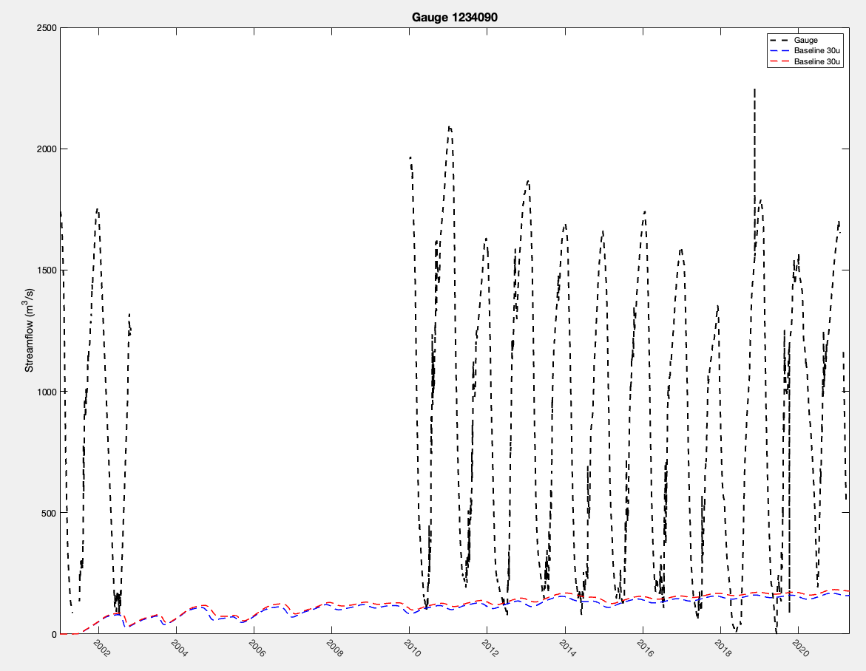
Gauge 1234090

